Slide 1
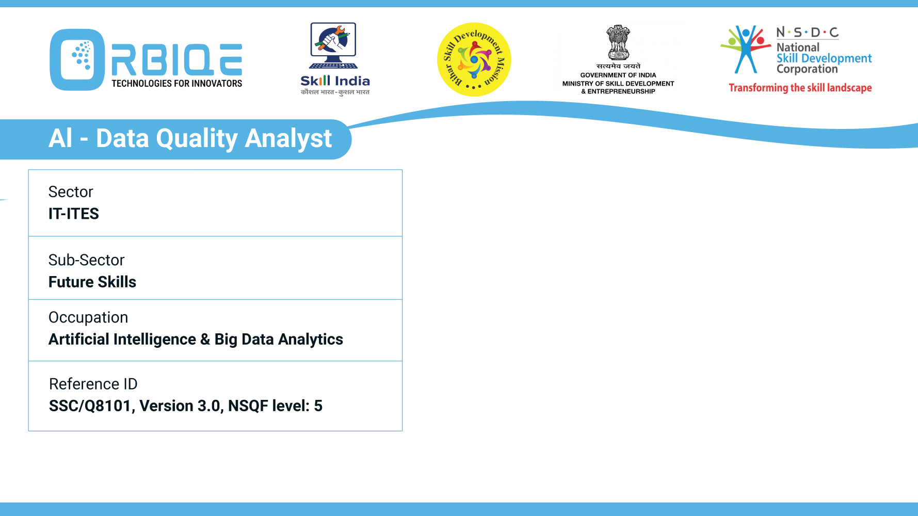
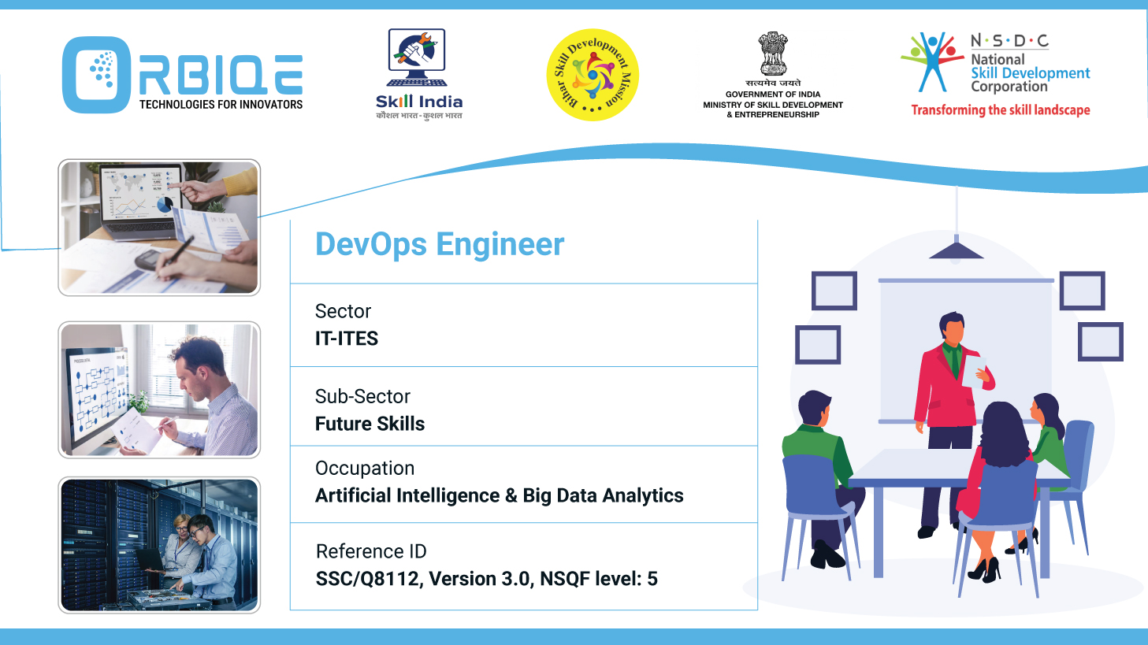
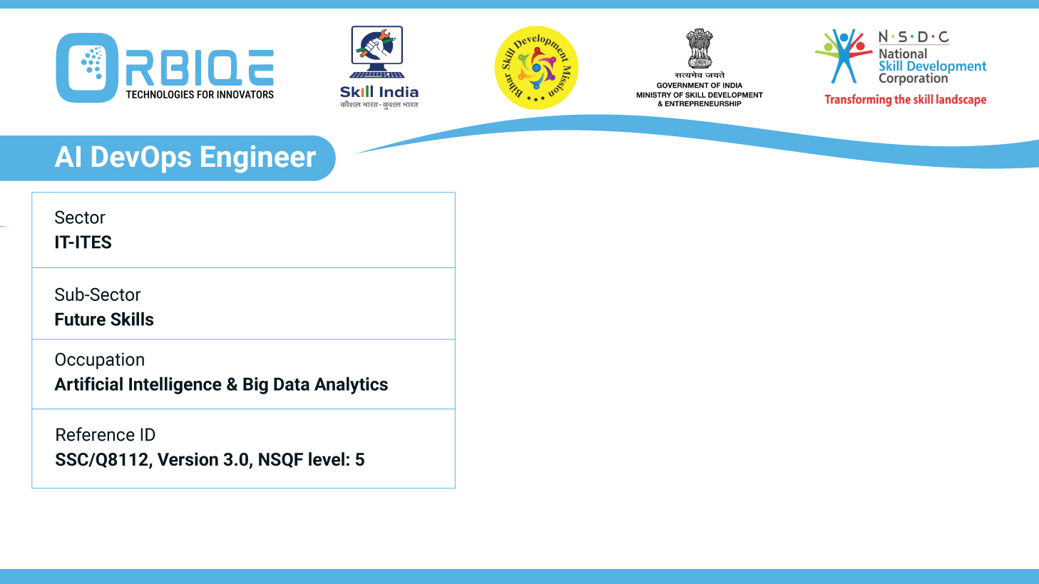
Name- Krishna Kant Dubey

Slide 2

Data Validation

Slide 3
Agenda
Organize and map metadata as per the needs of the analysis
Perform data profiling for data quality assessment and validation

Slide 4
Define the Analytical Goals
Before mapping metadata, clarify:
What questions are you trying to answer?
What variables are relevant?
What transformations or aggregations are needed?

Slide 5
Identify Core Metadata Elements
Metadata Category | Purpose | Example
Descriptive | What the data is | Customer_id, region, signup_date
Structural | How the data is organized | Table name: Customers, format: CSV
Administrative | Who owns it, when it was updated | Owner:Data team, Last Updated:2025-08-11
Statistical | Summary metrics | Mean Session Duration, null count
Provenance | Where it came from | Source: CRM API, ETL Pipeline:Airflow

Slide 6
Store and Access Metadata
In Code: Use Python dictionaries or YAML/JSON files.
In Database: Create a table or use a metadata catalog.
In Cloud: Use AWS Glue Data Catalog, Azure Purview, or Google Data Catalog

Slide 7
Automate Metadata Extraction
pandas_profiling or ydata-profiling for auto-generating metadata reports.
Great Expectations for validating metadata against expectations.
SQLAlchemy’s MetaData() class to introspect database schemas

Slide 8
Thank You

